Slide 1



<Something about Updates>
@ScotScottMcA

Slide 2


Who is familiar with WSUS?
Who has used WSUS before?
Has it made you grumpy?
Have you experienced issues, and were they easy to fix?
How regularly do you perform maintenance, if at all?
Who has nuked WSUS and started again?
How many WSUS servers do you have?

Slide 3

Why It’s Important to Love Your WSUS Server
Like anything you care about, it needs TLC
Car maintenance
Buying the wife gifts
Mowing the lawn
Keeping the fridge full of beer

Slide 4

What could happen if you don’t
Client scan performance
If you don’t carry out routine maintenance, you may well see your clients take hours, days, or even fail to complete their update scan, meaning your devices aren’t receiving updates
Lack of care on your upstream will affect downstream
Problems are multiplied like an uncontrolled rabbit population
May need to start from scratch
It’s entirely possible that your WSUS environment is so poorly maintained that the best course of action is to flatten it, reinstall and start from scratch
Notes:
https://learn.microsoft.com/en-us/troubleshoot/mem/configmgr/update-management/optimize-wsus-client-performance
https://learn.microsoft.com/en-us/troubleshoot/mem/configmgr/update-management/wsus-client-long-time-finish-update-scan
https://learn.microsoft.com/de-de/security-updates/windowsupdateservices/21669504

Slide 5

What could happen if you don’t
Disk Space (3rd party updates)
Even if you haven’t subscribed to a lots of products you can end up with WSUS consuming more space than you had originally planned for (UpdateServicesPackages / WSUSContent)
Database performance & Synchronization time
With the size of the WSUS catalogue continually growing, the DB does as well! And with increased database size and lack of maintenance comes poorer performance e.g. Sync Timeouts, increased SUP sync times and slowed query response times

Slide 6
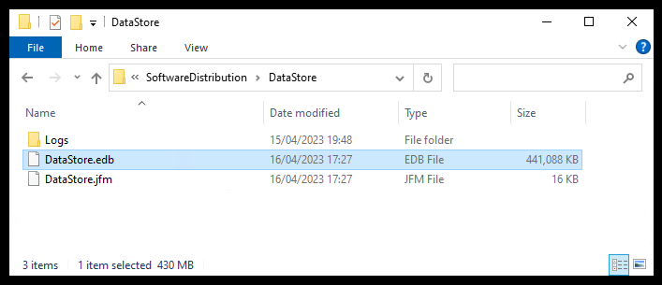
How to Take Care of & Maintain Your WSUS Server
Example of client-side DataStore.edb file for full catalogue and no clean-up

Slide 7
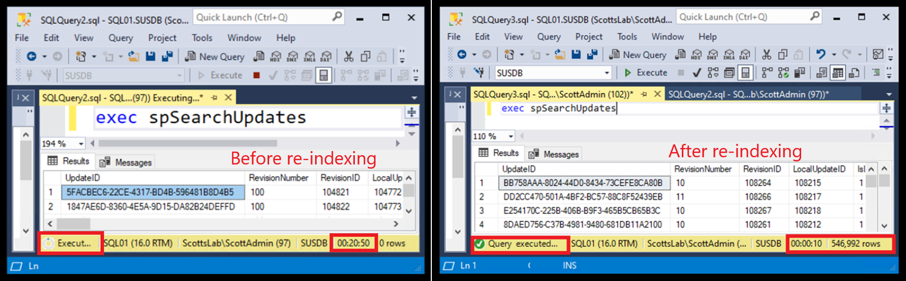
How to Take Care of & Maintain Your WSUS Server
Example of the query your clients and ConfigMgr run every sync
Re-Index SQL

Slide 8
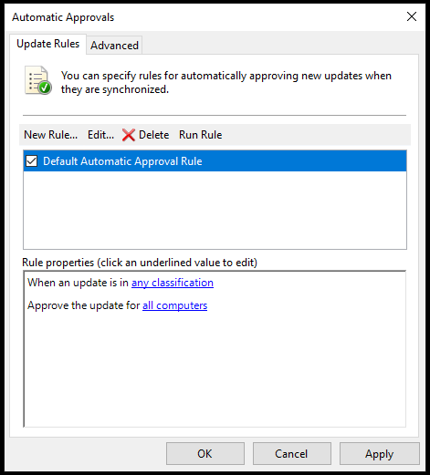
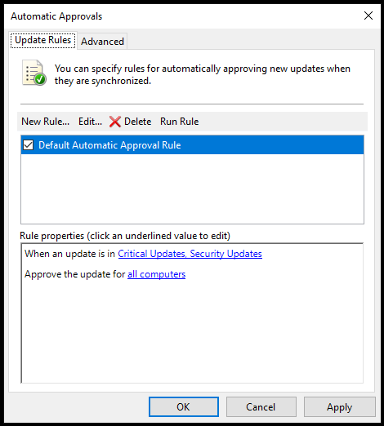
How to Take Care of & Maintain Your WSUS Server
Configure automatic approvals sensibly (WSUS standalone)
Don’t select any classification, be specific
Notes:
In fact don’t do this is it’s a SUP

Slide 9
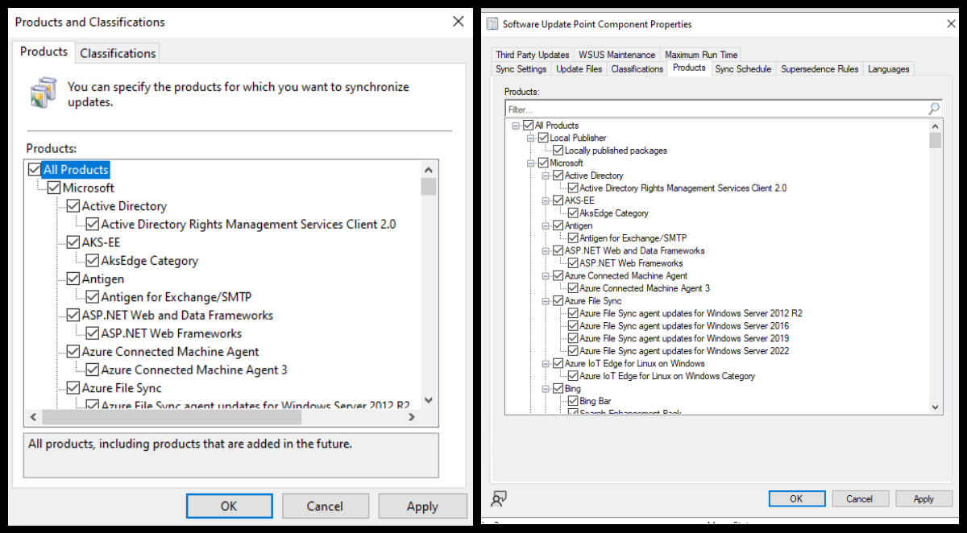
How to Take Care of & Maintain Your WSUS Server
Using WSUS?
Check for Un-Needed Products that are Enabled
Using ConfigMgr?
Product selection should be done on SUP, or it will be overwritten on sync in WSUS
Slide Tip: Throw something at any attendee with XP selected still
Notes:
Product selection should be done is SUP or it will be overwritten on sync

Slide 10
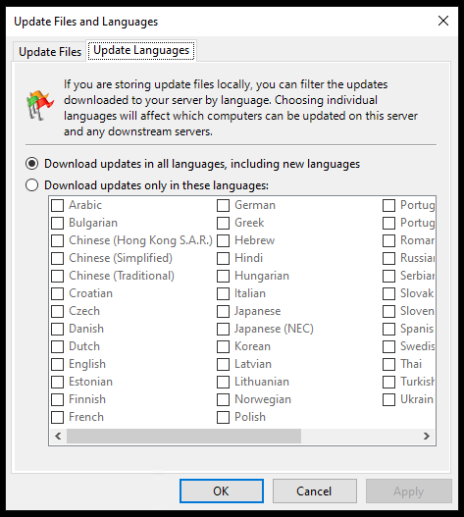
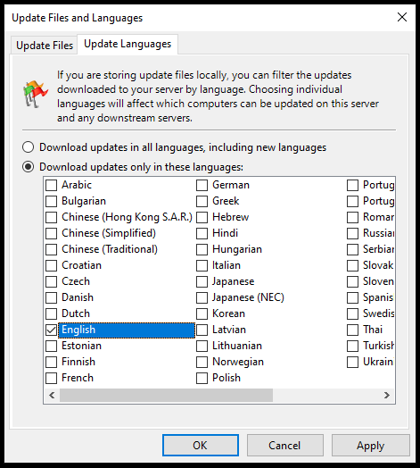
How to Take Care of & Maintain Your WSUS Server
Don’t sync unnecessary languages
More languages = more storage = more for clients to evaluate = bad times.
Notes:
Do on SUP properties if not WSUS standalone

Slide 11
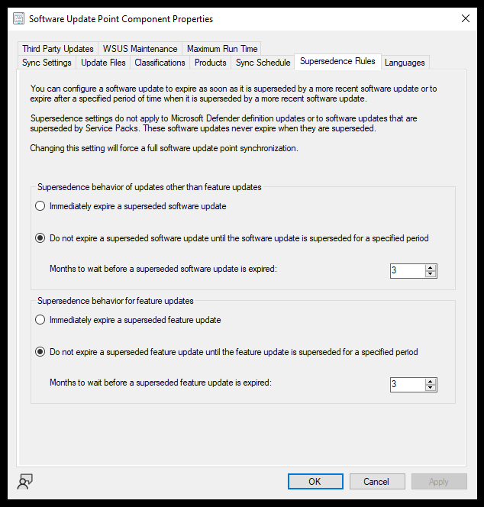
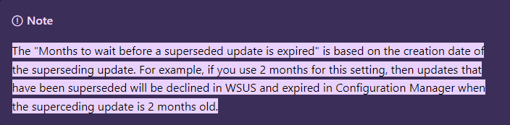
How to Take Care of & Maintain Your WSUS Server
Using ConfigMgr?
Supersedence Rules
Configuration Manager builds a list of superseded updates from its DB, based on the supersedence configuration of your SUP.
The updates meeting supersedence configuration criteria are expired in the Configuration Manager console.
The updates are declined in WSUS for CAS, primary, and secondary sites.
Configuration Manager cleans up the database every seven days, removing unneeded updates from the console.
This cleanup won't remove expired updates from the Configuration Manager console if they're currently deployed.

Slide 12
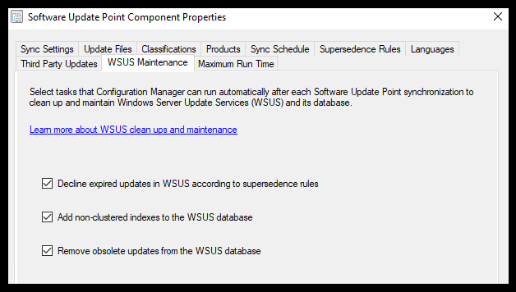
How to Take Care of & Maintain Your WSUS Server
Using ConfigMgr?
Enable the Built-In WSUS Maintenance in ConfigMgr 1906 and Newer
Decline expired updates in WSUS according to supersedence rules
The more updates you have, the larger the catalogue sent to your clients. Declining updates in WSUS that are not required reduces the size of that catalogue, improving performance.
Add non-clustered indexes to the WSUS database
The most significant improvement to WSUS performance is adding these non-clustered indexes to tbLocalizedPropertyForRevision & tbRevisionSupersedesUpdate as it speeds up queries against these tables, allowing for quicker clean-up of unneeded updates.
Remove obsolete updates from the WSUS database
Updates that are no longer in the MS Catalogue, and not required, are considered obsolete. Removing obsolete updates clears them from your WSUS DB, again, improving performance
Notes:
Go to LAB
Show indexes Add note about the re-indexing maint plan?

Slide 13
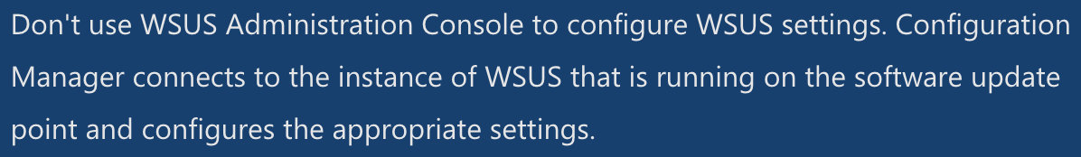
How to Take Care of & Maintain Your WSUS Server
Decline updates you don’t need
We are told not to use the WSUS console if we are using ConfigMgr – ignore that advice ONLY to manually decline updates that may not be picked up in the SUP maintenance (more on that later)
Notes:
Any updates that are declined will no longer be offered to a client, either for evaluation or installation – including superceded updates
Dell applicability rules SUCK – WMI detection used..it WILL KILL YOUR CPU

Slide 14


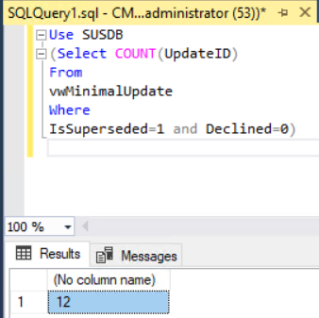
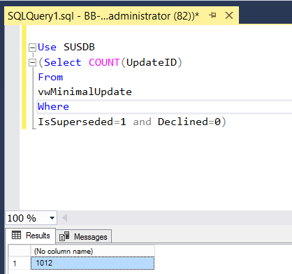
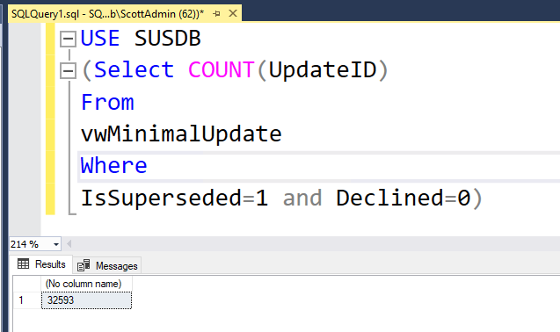


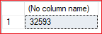
How to Take Care of & Maintain Your WSUS Server
Microsoft says – we expect less than 1500 superseded updates to scan against
Select COUNT(UpdateID) From vwMinimalUpdate Where IsSuperseded=1 and Declined=0
LAB
TIME
GOOD BAD UGLY
Notes:
Use SUSDB
(Select COUNT(UpdateID)
From
vwMinimalUpdate
Where
IsSuperseded=1 and Declined=0)

Slide 15
How to Take Care of & Maintain Your WSUS Server
Remove Obsolete Updates
Obsolete updates are unused updates and update revisions in the WSUS database. Generally speaking, an update is considered obsolete once it's no longer in the MS catalog and it isn't needed by other updates as a prerequisite or dependency.
Notes:
Wont work on a remote WID SUSDB – cleanup from the bottom up in the hierarchy is important!

Slide 16
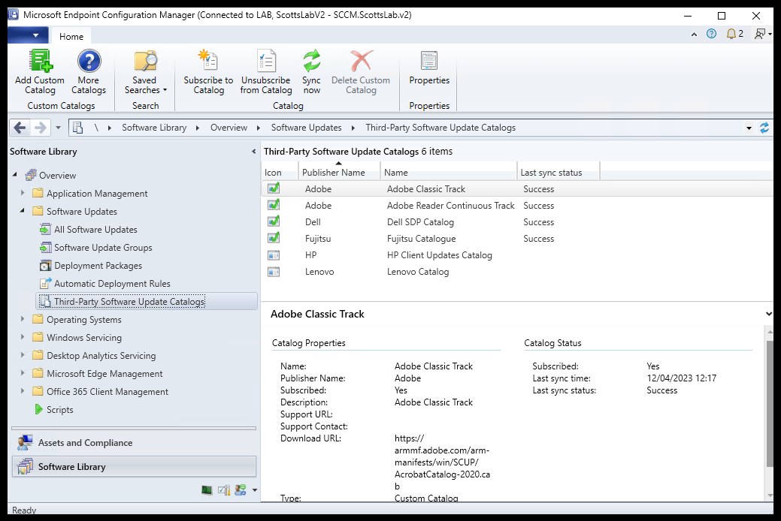
How to Take Care of & Maintain Your WSUS Server
Using ConfigMgr?
Unsubscribe from unnecessary catalogues

Slide 17

How to Take Care of & Maintain Your WSUS Server
Re-Index SQL
Microsoft provide a T-SQL script that
Identifies fragmented indexes and defrags them
Adds fill factors to improve insert performance
Updates potentially out-of-date table stats
Notes:
Reindex the Windows Server Update Services (WSUS) database - Configuration Manager | Microsoft Learn

Slide 18
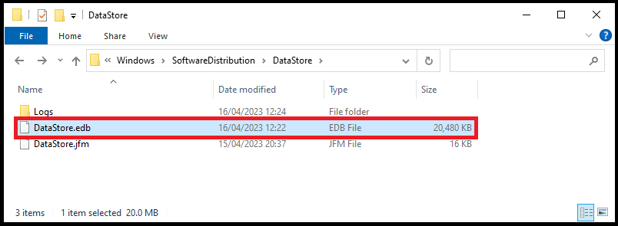
How to Take Care of & Maintain Your WSUS Server
Example of client-side DataStore.edb file for a maintained catalogue

Slide 19
How to Take Care of & Maintain Your WSUS Server
Example of the query your clients and ConfigMgr run every sync
Re-Index SQL

Slide 20
How to Take Care of & Maintain Your WSUS Server
Other beneficial performance changes
IIS
Queue Length
Idle Time-out
Ping
Private Memory Limit
Regular Time
Using WID?
Indexes are not automatically created
SQL
Reindexing is not automatic; schedule it
Apply SQL best practices, a database is still a database!
Re-Index SQL

Slide 21

Community Tools to Make Your WSUS Servers Life Easier / Do you want to do this manually?
SCCM/MECM WSUS Maintenance Guide – Scott Fairchild
Rebuilding WSUS – Mariano Grande (Microsoft)
The Simple Guide to WSUS Maintenance – Patch My PC
Fixing WSUS – The best defense is a good offense – Johan Arwidmark
Clean up WSUS UpdateServicesPackages – Patch My PC
MEM Patching Optimizer – Patch My PC
SQL Server Maintenance Solution – Ola Hallengren

